Slide 1


AptoSaver
Crypto Fixed Deposit with 10%+ Yield & Lottery on Aptos
Bridging Web2 users into DeFi through familiar savings products

Slide 2

DeFi Adoption Barriers
Complexity Fear
Trust Issues
Web2 users intimidated by DeFi's technical complexity and volatility risks
Unpredictable returns, lock-in periods, and unfamiliar protocols create hesitation
Access Barriers
Limited fiat onramps restrict adoption in key emerging markets like India and Africa

Slide 3
Our Solution
01
02
03
Familiar Fixed Deposits
Complete Liquidity
Smart Optimization
10%+ APY with easy-to-understand savings structure
Instant withdrawals, no penalties, full reward payouts
Automated yield optimizer reallocates funds to top protocols
04
05
Lottery Rewards
Fiat Integration
Gamified savings funded by excess yield above 10% APY
Direct onramp access for India, Africa, and emerging markets

Slide 4
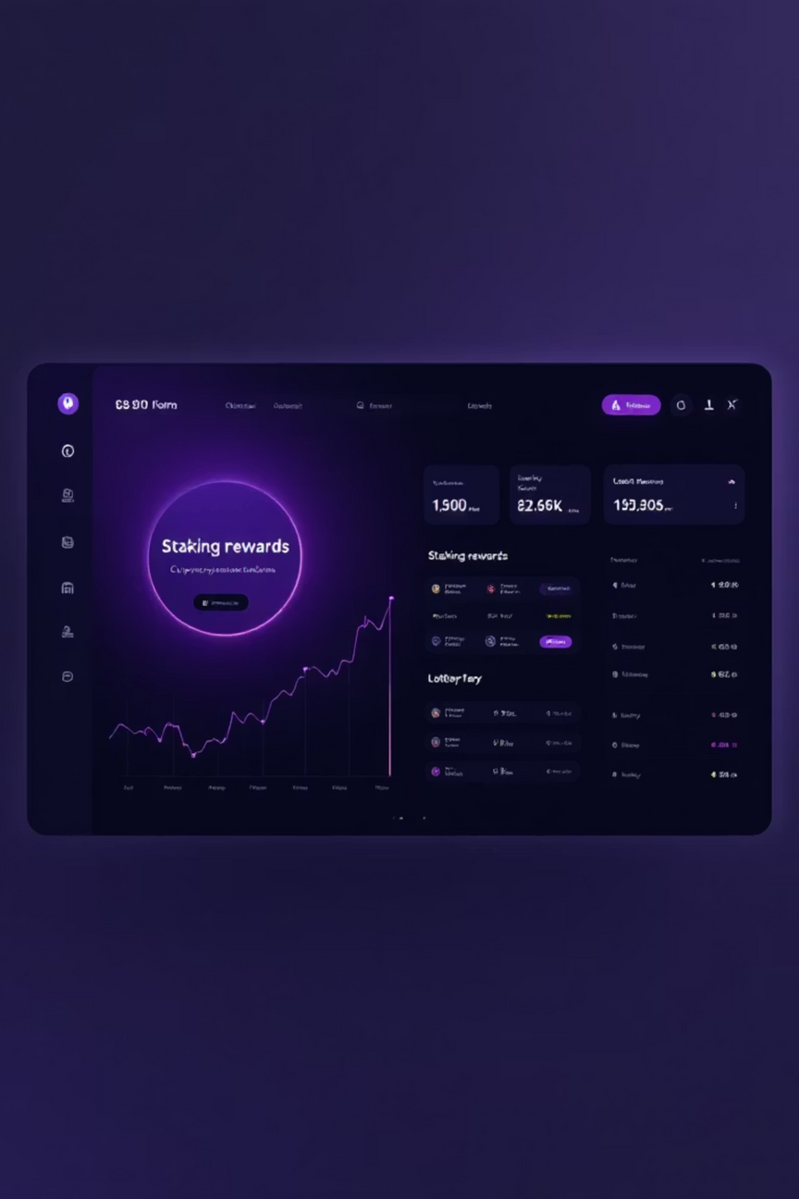
Platform Demo
Core Flow
Lottery System
APT deposits auto-swap to stablecoins
Winners chosen via Aptos randomness API
Funds staked via Cellana Finance
Transparent on-chain selection
Real-time dashboard tracking
Automated backend optimization
One-click instant withdrawals
Fair, unbiased reward distribution

Slide 5




Aptos Usage
Panora Swap Aggregator
Panora Swap aggregates liquidity from all major Aptos DEXs delivering optimal stablecoin swap routes with minimal slippage.
Cellana Finance
Cellana Finance offers stablecoin staking pools with ~13% APR allowing AptoSaver to provide consistent yield of 10% APY.
True Randomness
On-chain randomness API ensures unbiased, transparent lottery winner selection without manipulation

Slide 6
Competitive Landscape
Platform
Yield
Lock-in
Lottery
Fiat
Chain
Web2 Friendly
Traditional Banks
4-8%
Yes
No
Yes
Centralized
High
ZebPay
8.5%
Yes
No
Limited
Centralized
Medium
Nexo
15%
Yes
No
Medium
Centralized
Medium
PoolTogether
Variable
No
Yes
No
Ethereum
Low
AptoSaver
10%+
No
Yes
Yes
Aptos
High
Unique Position
Only platform combining fixed deposit familiarity with DeFi yields, complete liquidity, and emerging market access

